Slide 1
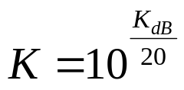
PollEv Check on Gain Margin - 1
https://pollev.com/kathrynjohns083
Which of the following should be your first step for computing the gain margin?
  locate the frequency ω_{co} where the magnitude Bode plot crosses 0 dB
  locate the frequency ω₁₈₀ where the phase Bode plot crosses
  -180 deg
  determine how far the low-frequency gain is above or below
  0 dB
  convert the low-frequency gain K_{dB} from dB to scaling factor (gain) K using

Slide 2
PollEv Check on Gain Margin - 2
https://pollev.com/kathrynjohns083
Which of the following is not a step for computing the gain margin?
  locate the frequency ω_{co} where the magnitude Bode plot crosses 0 dB
  locate the frequency ω₁₈₀ where the phase Bode plot crosses
  -180 deg
  determine how far the low-frequency gain is above or below
  0 dB
  convert the low-frequency gain K_{dB} from dB to scaling factor (gain) K using
Notes:
Note: both A and C are correct

Slide 3
PollEv Check on Phase Margin
https://pollev.com/kathrynjohns083
Which of the following should be your first step for computing the phase margin?
  locate the frequency ω_{co} where the magnitude Bode plot crosses 0 dB
  locate the frequency ω₁₈₀ where the phase Bode plot crosses
  -180 deg
  determine how far the low-frequency gain is above or below
  0 dB
  convert the low-frequency gain K_{dB} from dB to scaling factor (gain) K using

Slide 4
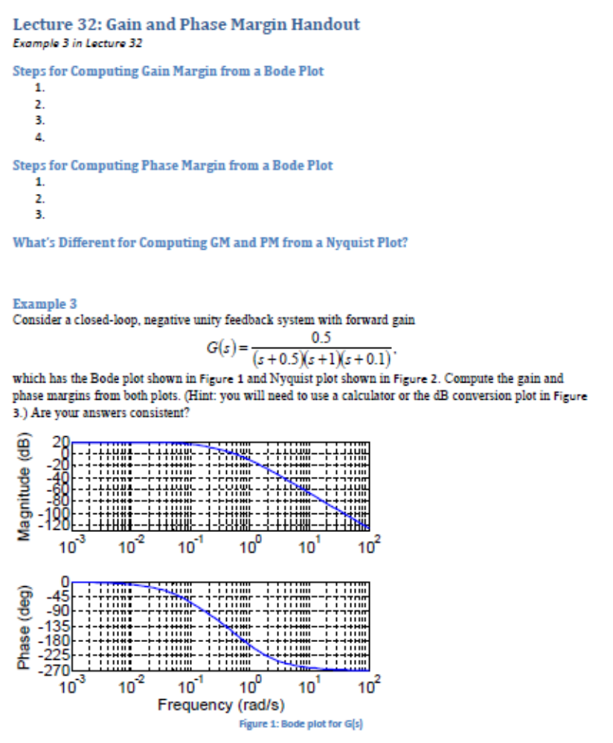
Handout Reminder
Reminder from last time: can use this handout

